Slide 1
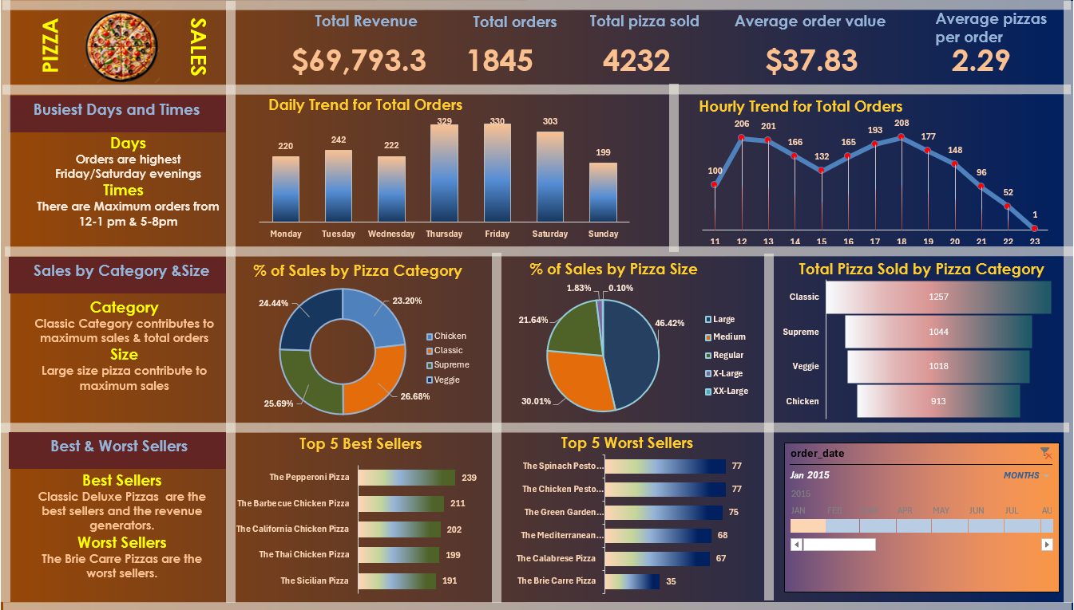
Pizza sales Data Analysis Project
Analysing Sales Performance Using SQL & Excel Dashboard
By:
Tanusri Paul
Tools used:
MySQL | Excel | Powerpoint
Date:
March 2026

Slide 2
PROBLEM STATEMENT
KPI’s REQUIREMENT
Analyze key indicators for pizza sales data to gain insights into business performance. Specifically, calculate the following metrics:
Total Revenue: The sum of the total price of all pizza orders.
Average Order Value: The average amount spent per order, calculated by dividing the total revenue by the total number of orders.
Total Pizzas Sold: The sum of the quantities of all pizzas sold.
Total Orders: The total number of orders placed.
Average Pizzas Per Order: The average number of pizzas sold per order, calculated by dividing the total number of pizzas sold by the total number of orders.

Slide 3
PROBLEM STATEMENT
CHARTS REQUIREMENT
Visualize various aspects of pizza sales data to gain insights and understand key trends. Identified the following requirements for creating charts:
Daily Trend for Total Orders:Create a bar chart that displays the daily trend of total orders over a specific time period. This chart will help us identify any patterns or fluctuations in order volumes on a daily basis.
Hourly Trend for Total Orders:Create a line chart that illustrates the hourly trend of total orders throughout the day. This chart will allow us to identify peak hours or periods of high order activity.
Percentage of Sales by Pizza Category:Create a pie chart that shows the distribution of sales across different pizza categories. This chart will provide insights into the popularity of various pizza categories and their contribution to overall sales.
Percentage of Sales by Pizza Size:Generate a pie chart that represents the percentage of sales attributed to different pizza sizes. This chart will help us understand customer preferences for pizza sizes and their impact on sales.

Slide 4
Total Pizzas Sold by Pizza Category: Create a funnel chart that presents the total number of pizzas sold for each pizza category. This chart will allow us to compare the sales performance of different pizza categories.
Top 5 Best Sellers by Total Pizzas Sold: Create a bar chart highlighting the top 5 best-selling pizzas based on the total number of pizzas sold. This chart will help us identify the most popular pizza options.
Bottom 5 Worst Sellers by Total Pizzas Sold: Create a bar chart showcasing the bottom 5 worst-selling pizzas based on the total number of pizzas sold. This chart will enable us to identify underperforming or less popular pizza options.

Slide 6
Key Insights
📈 Total revenue generated is $69,793.3 from 1,845 orders, with a total of 4,232 pizzas sold.
📅 Sales are highest on Fridays and Saturdays, indicating strong weekend demand.
⏰ Peak ordering hours are between 12–1 PM and 5–8 PM, showing lunch and dinner rush periods.
🍕 Classic pizza category contributes the highest share of total sales and orders, making it the most popular category.
📊 Large-sized pizzas contribute the maximum sales (around 46%), indicating customer preference for larger portions.
🥇 Top-selling pizzas include Classic Deluxe pizzas, driving major revenue.
📉 Worst-selling pizzas include Brie Carre pizza, indicating low customer demand for certain varieties.

